Slide 1

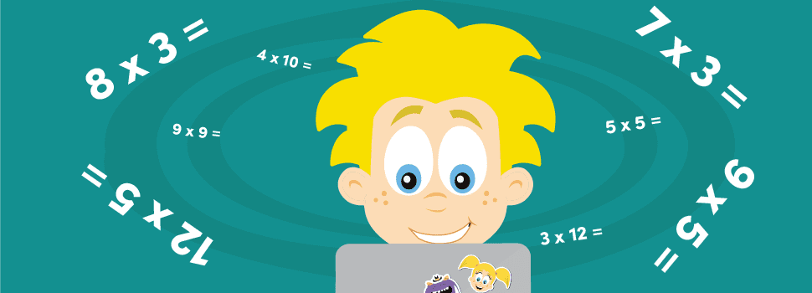
Welcome to the Year 4 Parents’ Meeting:
Multiplication Tables Check

Slide 2
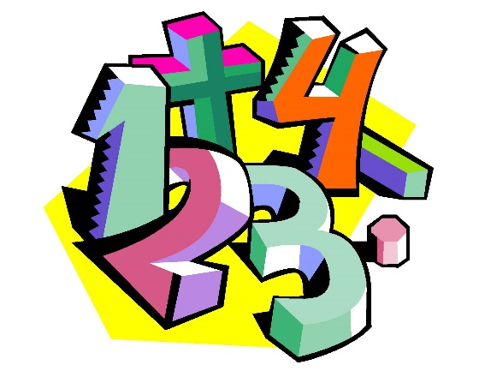
Aims of today
to give information about the statutory Multiplication Tables Check
to take away some ideas to support your children at home

Slide 3
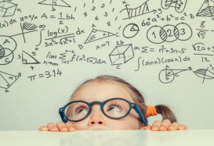
What is the multiplication tables check?
The purpose of the MTC is to determine whether Year 4 pupils can fluently recall their multiplication tables.
2022 will be the first year that the test is mandatory for schools.
There is no pass mark or threshold and children will not be required to resit the test.

Slide 4
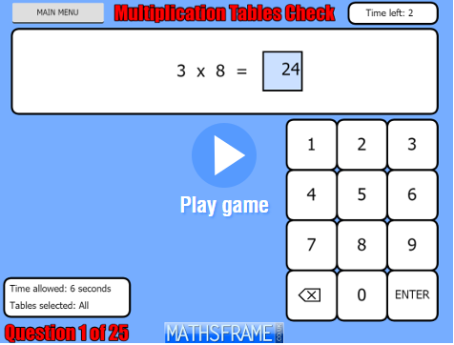
Administration of the test
The times tables check is online and on-screen and as a school this will be done on the Chromebooks, that the children are familiar with using.
Children will have a chance to practise ahead of the test so they can understand the format and speed of questions.
The MTC will only present children with multiplication statements not division.
The check will take place in June each year, when there will be 3-week window to take the test – there is no set day to take it.
Results will be available to schools at the end of the 3-week window and will be reported to parents at the end of the year.

Slide 5
Children can practise before taking the check
Before the test window opens each year, there will be the opportunity for children to access a practice area to become familiar with the style of the KS2 times tables test.
We will build in time for this familiarisation, so the check style is not new when children take the actual check.
It will take less than 5 minutes per pupil for them to complete the test.
Children will be presented with 25 questions with a 3 second pause in-between each question, before the next one appears on screen.

Slide 6
Timing
Children will get 6 seconds from the time the question appears to input their answer. This means that children must be able to read, recall and enter their response within this time.
As the facts have to be read by the child (rather than being read to them), it is also important that children are used to giving the correct answer to multiplication questions in a written format, rather than only answering questions out loud.
Whatever is in the answer box at the end of the 6 seconds will be counted as the answer This means that if a child is mid-way into entering a two digit answer (e.g. they only enter the 7 out of 72 when answering 8 x 9) they will be recorded as having answered 8 x 9 as 7.
Let’s see what this looks like…
https://mathsframe.co.uk/en/resources/resource/477/Multiplication-Tables-Check

Slide 7
Recalling facts
It is vital that children are able to rapidly recall multiplication facts, and can do so out of sequence (i.e. answer 6 x 7 without having to count in 6s from 0).
Whilst it may be tempting to resort to rote learning for the multiplication tables, it is important that this is not the only way they are practised, as it leads to children simply being able to chant facts without any meaning, and reduces their ability to recall facts out of sequence.
Children need to be able to rapidly recall their multiplication facts – this will help them to calculate in other areas of maths as well (especially in the arithmetic test in Y6 SAT’s). Times tables knowledge is vital for quick mental maths calculations and problem solving, as well as for many of the topics children learn in KS2 – including division, fractions, percentages, ratio and basic algebra. In secondary school, good multiplication skills are a great help when with algebra, as well as chemistry, physics, biology and ICT, all of which use this maths knowledge.

Slide 8
Tables to be tested
The check has been designed to focus on times tables that fit within the KS2 national curriculum.
By the end of Year 3, children must be fluent in the 2, 3, 4, 5, 8, 10 times tables, and then by the end of Year 4 all of the above plus the 6, 7, 9, 11, 12.
The 6, 7, 8, 9 and 12 times tables are more likely to be asked than the 2, 3, 4, 5, 10 or 11 multiplication tables. The STA (Standards and Testing Agency) state that there is a focus on these as these are the most difficult multiplication tables.
There will not be an equal spread of each multiplication table within the check.
There will always be questions from the 3, 4, 5, 6, 7, 8, 9, 11 and 12 multiplication tables in each test
There will be no questions from the 1 times table (i.e. 1 x 8 or 8 x 1)
There will only be a maximum of 7 questions from the 2, 5 and 10 times tables

Slide 9
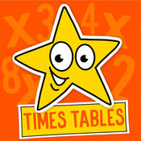
Tables to be tested
It is important that children understand that 8 x 3 (8, three times) is the same as 3 x 8 (3, eight times.)
Therefore, if children have made this conceptual connection, it effectively reduces the number of unique facts children need to remember, and helps children answer questions such as 8 x 4, which if taken as an 8 times table question may cause more panic than 4 x 8.
Eleven facts are more likely to appear than others
•6 x 6, 6 x 7, 6 x 8, 6 x 9, 6 x 12
•7 x 8, 7 x 9, 7 x 12
•8 x 9, 8 x 12
•12 x 12
and their commutative equivalents.

Slide 10
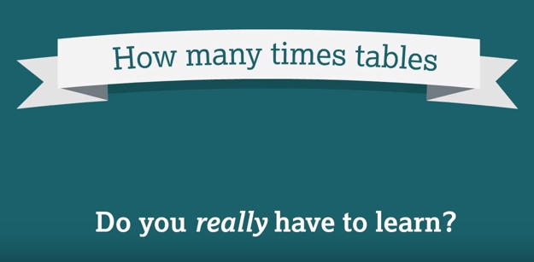
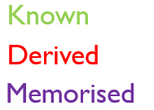
https://www.youtube.com/watch?v=pSb40J9pcck
 |  |  |  |  |  |  |  |  |  |  | 12 x 12
 |  |  |  |  |  |  |  |  |  | 11 x 11 | 12 x 11
 |  |  |  |  |  |  |  |  | 10 x 10 | 11 x 10 | 12 x 10
 |  |  |  |  |  |  |  | 9 x 9 | 10 x 9 | 11 x 9 | 12 x 9
 |  |  |  |  |  |  | 8 x 8 | 9 x 8 | 10 x 8 | 11 x 8 | 12 x 8
 |  |  |  |  |  | 7 x 7 | 8 x 7 | 9 x 7 | 10 x 7 | 11 x 7 | 12 x 7
 |  |  |  |  | 6 x 6 | 7 x 6 | 8 x 6 | 9 x 6 | 10 x 6 | 11 x 6 | 12 x 6
 |  |  |  | 5 x 5 | 6 x 5 | 7 x 5 | 8 x 5 | 9 x 5 | 10 x 5 | 11 x 5 | 12 x 5
 |  |  | 4 x 4 | 5 x 4 | 6 x 4 | 7 x 4 | 8 x 4 | 9 x 4 | 10 x 4 | 11 x 4 | 12 x 4
 |  | 3 x 3 | 4 x 3 | 5 x 3 | 6 x 3 | 7 x 3 | 8 x 3 | 9 x 3 | 10 x 3 | 11 x 3 | 12 x 3
 | 2 x 2 | 3 x 2 | 4 x 2 | 5 x 2 | 6 x 2 | 7 x 2 | 8 x 2 | 9 x 2 | 10 x 2 | 11 x 2 | 12 x 2
1 x 1 | 2 x 1 | 3 x 1 | 4 x 1 | 5 x 1 | 6 x 1 | 7 x 1 | 8 x 1 | 9 x 1 | 10 x 1 | 11 x 1 | 12 x 1

Slide 11
Access arrangements
There are several access arrangements available for the check, which can be used to support pupils with specific needs. Your child’s teacher will ensure that the access arrangements are appropriate for your child before they take the check in June.
The check has been designed so that it is inclusive and accessible to as many children as possible, including those with special educational needs or disability (SEND) or English as an additional language (EAL).

Slide 12
How can you help your child?
Complete any times tables homework sent by the teachers – including Sumdog challenges
Play times tables games online to help support inputting answers in to a given format – there are a variety of websites:
https://mathsframe.co.uk/en/resources/resource/477/Multiplication-Tables-Check
https://www.timestables.co.uk/multiplication-tables-check/
https://www.topmarks.co.uk/maths-games/daily10

Slide 13

Any questions?

