Slide 1
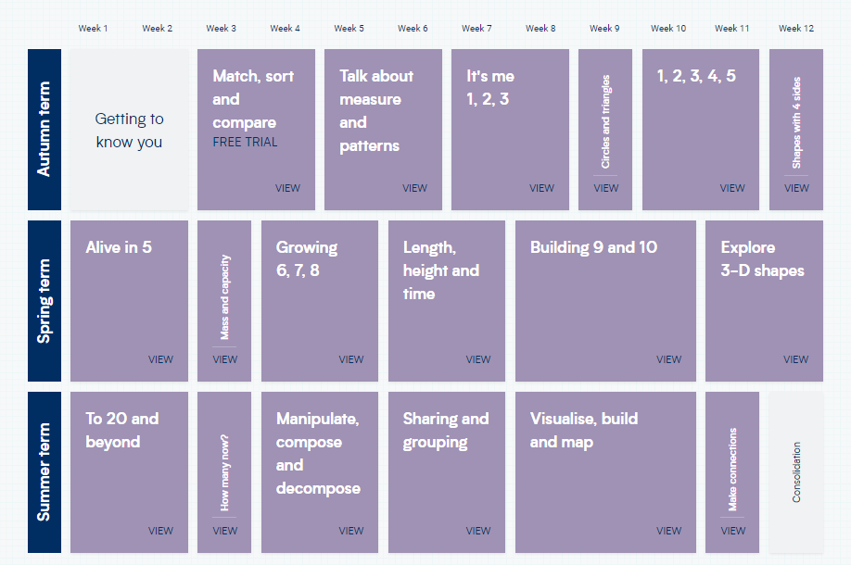
EYFS – Yearly Overview
The EYFS curriculum is currently being adapted to use Mastering Number resources as the basis for daily maths sessions.
Shape, space and measures will continue to be taught using White Rose units.

Slide 2
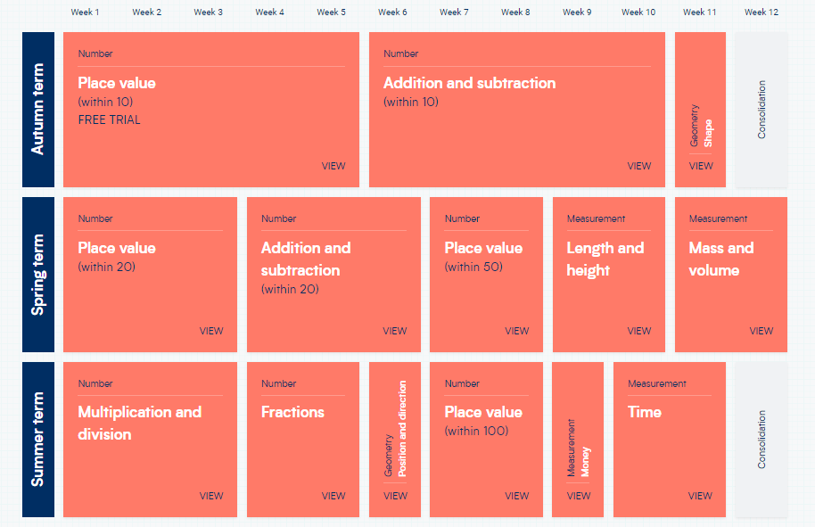
Year 1 – Yearly Overview

Slide 3
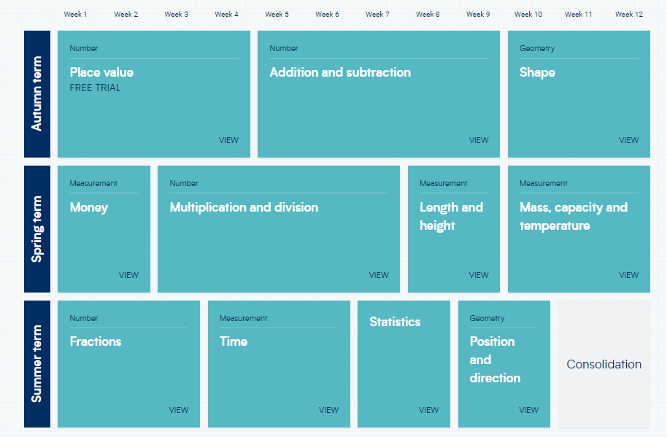
Year 2 – Yearly Overview

Slide 4
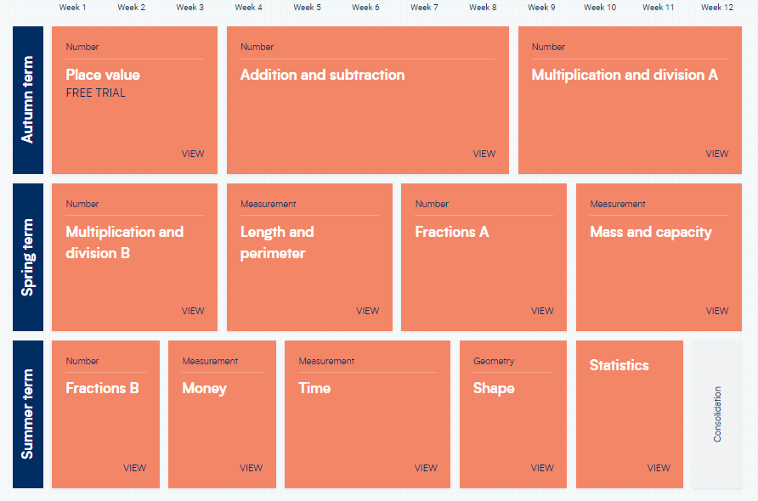
Year 3 – Yearly Overview

Slide 5
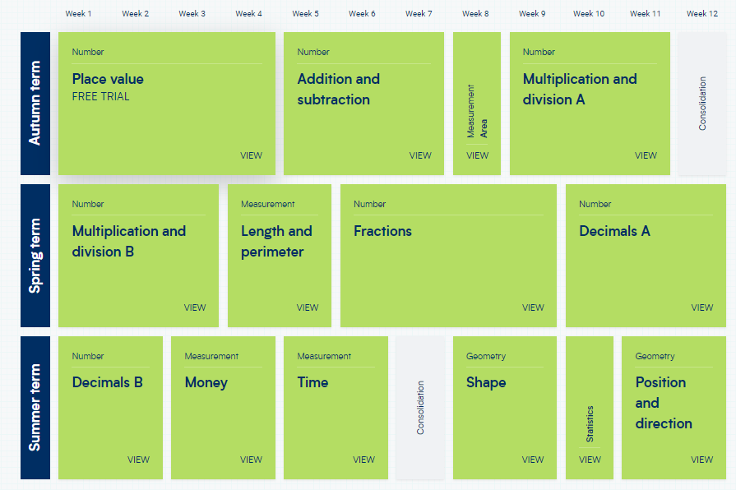
Year 4 – Yearly Overview

Slide 6
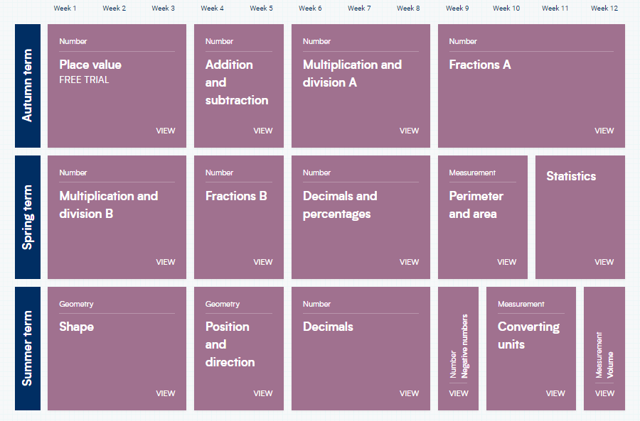
Year 5 – Yearly Overview

Slide 7
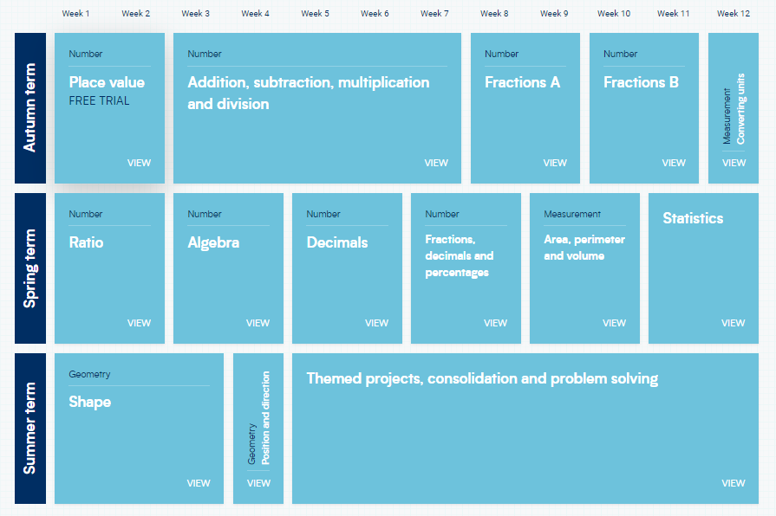
Year 6 – Yearly Overview

