Slide 1
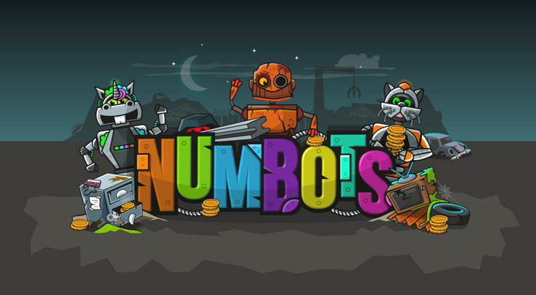


Slide 2
NumBots –What is it?
★NumBots is a highly engaging platform for supporting children when learning to add and subtract.
★ NumBots is all about every child achieving the “triple win” of understanding, recall and fluency in mental addition and subtraction so that they move from counting to calculating.
Notes:
Start the launch session with the children sat away from the computers/tablets, so they aren’t distracted by the devices. (At slide 16 they’ll move to their devices – but we’ll remind you, don’t worry!)

Slide 3
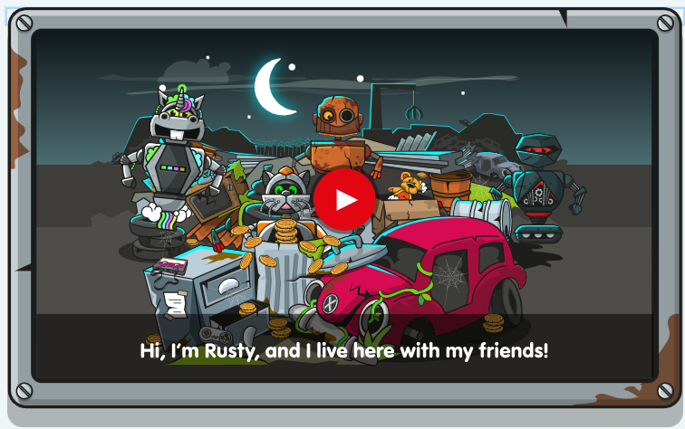
Before the Game
Children are welcomed to the game with an opening video, where they are introduced to the central character, “Rusty”. In the video, Rusty asks for help in his quest to find new parts to upgrade him to a diamond robot, so he can “shine inside and out, like a Diamond”. Next, the child will be able to choose a bot name they will play under, as well as their own robot character.
https://youtu.be/AeO2u2bSD6A

Slide 4

How the game works
There are two playmodes in NumBots that serve different purposes.
Story Mode for understanding - the emphasis is on mathematical concepts and is underpinned by a mastery approach to teaching. Story Mode features visual representations, procedural variation, exposure to different calculation strategies and interleaved material all in very carefully sequenced order.
Challenge Mode for recall - the emphasis is on rapid responses to essential facts and simple sums, against the clock.

Slide 5

Playing the Game: Story Mode
The game starts in ‘Story Mode’. Here there are 18 stages which each contain multiple levels. Children’s NumBots journey will start on Stage 1 (Rust): Level 1. To unlock the next level, they are required to pass each level with at least 2 out of 3 stars. Once they’ve completed all the levels in Rust Stage, they will be taken to Stage 2 (Iron). As they progress through the levels, they will collect new parts to upgrade Rusty, with the ultimate goal of completing the eighteenth stage: Diamond.
In order to earn the 2 or 3 stars required to pass the level, children must demonstrate a level of fluency when answering the questions. This means they must be accurate and timely with their answers; if children get 0 or 1 stars they need to answer more quickly. A child will not move onto the next level until they are prepared for it – which is why they must prove they’ve mastered the previous skill.
Story Mode starts with very basic maths: subitising numbers. As the levels have been meticulously planned with a “teaching for mastery” approach, each level gradually develops in complexity, with one skill building upon the next.
It is important that children don’t feel pressured to answer too quickly as they learn to play.

Slide 6
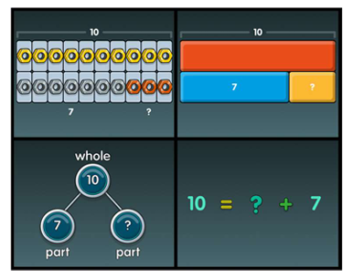
Key representations:
A part add a part is equal to the whole.
The whole is equal to a part add a part.

Slide 7
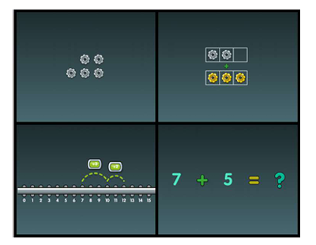
Key representations:

Slide 8

Playing the Game: Challenge Mode
When children complete Stage 3 (Tin): Level 35 in Story Mode, they will unlock Challenge Mode. Here children can race the clock to test themselves on how many questions they can answer correctly in one minute. Children have 20 different challenges to choose from; each challenge testing a different skill, for example number bonds to 10. This means that they can select the particular skill that they wish to improve their time on.
Use this mode with caution, as we don’t want to create maths anxiety.

Slide 9
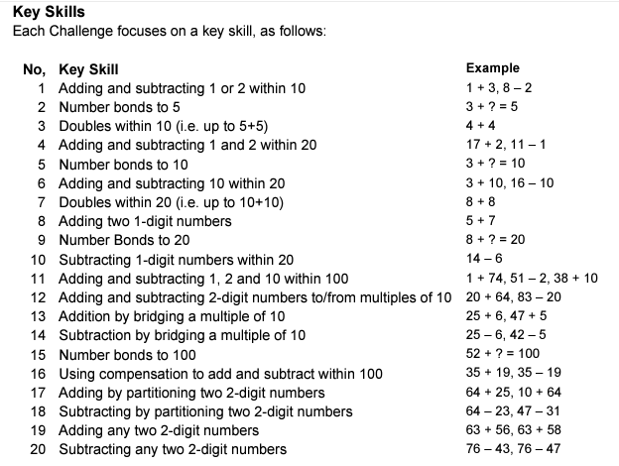

Slide 10
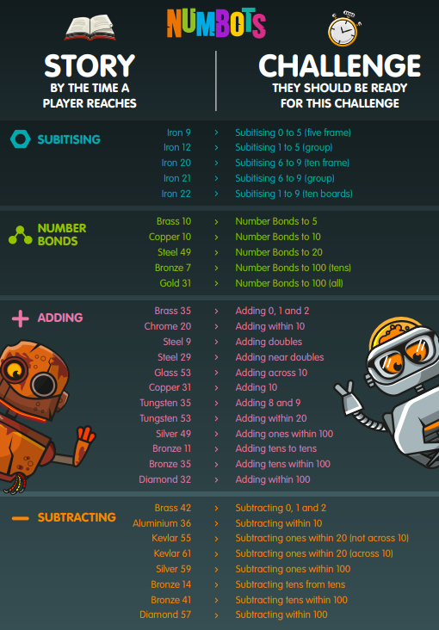

Slide 11
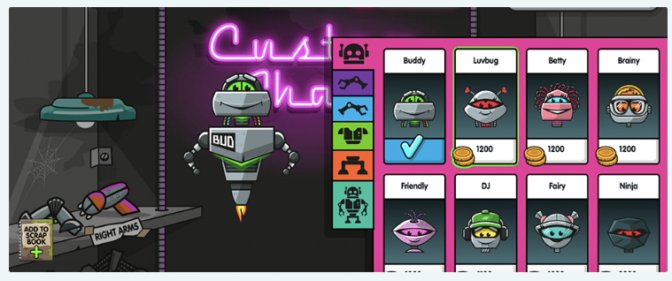
The Custom Shack
For every maths question answered correctly, the children will receive coins to spend in the Custom Shack. Here, they are able to purchase new parts to upgrade and personalise their own robot character. As well as earning coins, children are kept motivated throughout their NumBots journey by collecting badges and winning trophies to reward their achievements.

Slide 12
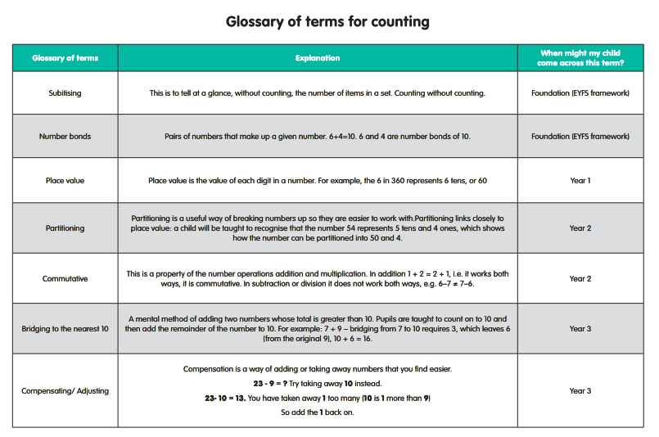

Slide 13
How can parents support?
• We recommend that children play for 5-10 minutes a day, 4 or 5 days a week. Little and often is best!
• There will be times when they need your help understanding what to do (to help with that, there is an info slide before each level begins) or even with typing in the answers.
• They may need encouragement from time to time and they may benefit from being reminded that making mistakes is something perfectly natural.
• They could also reach a point in the maths that is beyond their reach for now; if it feels like they’ve reached a blocker, we’d recommended returning to earlier levels and trying to complete them with 3 stars.
• If children are still finding it difficult to complete levels with 2 stars, speak to your teacher. They can change the story settings or help with strategies.

Slide 14
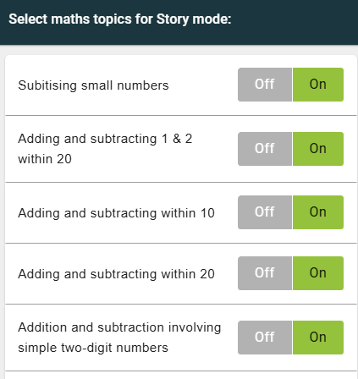
What can the teacher do?
They can set the story difficulty –giving more time per question.
They can set topics on and off. This may help if your child is a little overwhelmed!

Slide 15
Let’s Play!
★Let’s have a look at how NumBots looks.

Slide 16


Helping your child and Rusty to shine like a diamond!
Any questions?

