Slide 1



Slide 2

Aims
★ What is TTRockstars?
★ Why?
★ Parents’ Guide.
★ Let’s have a look!
★ Any questions?

Slide 3
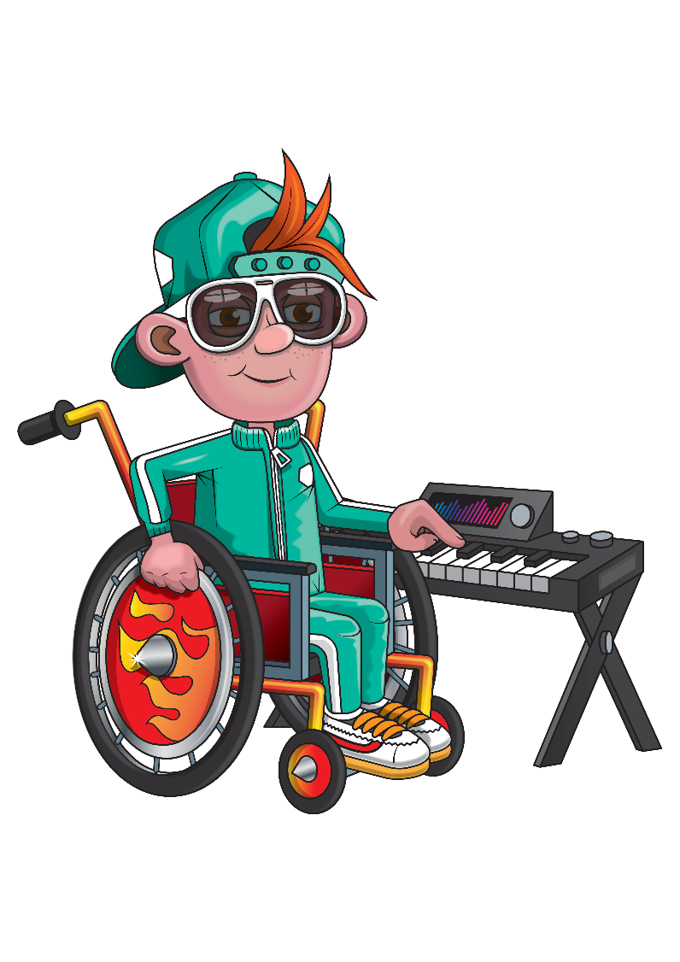
WHAT IS TIMES TABLES ROCK STARS?
Times Tables Rock Stars is an award-winning maths learning platform where children can practise their times tables like a rock star!
It is suitable for all learners aged 6 years and up and the question-based games automatically adapt to each child’s unique learning needs, helping them to recall their times tables in record speed. It is accessible on any device, via the app or browser so children can play anytime, anywhere.
The engaging gamification and motivating rewards hopefully mean it is never difficult to entice children to play.
At St Martin’s we recommend a “little and often” approach.
Our homework policy suggests that 3 minutes practice a day, 4 or 5 times a week is a good target.

Slide 4




Why is it important to recall multiplication and division facts with confidence?
@TTRockStars
ttrockstars.com

Slide 5
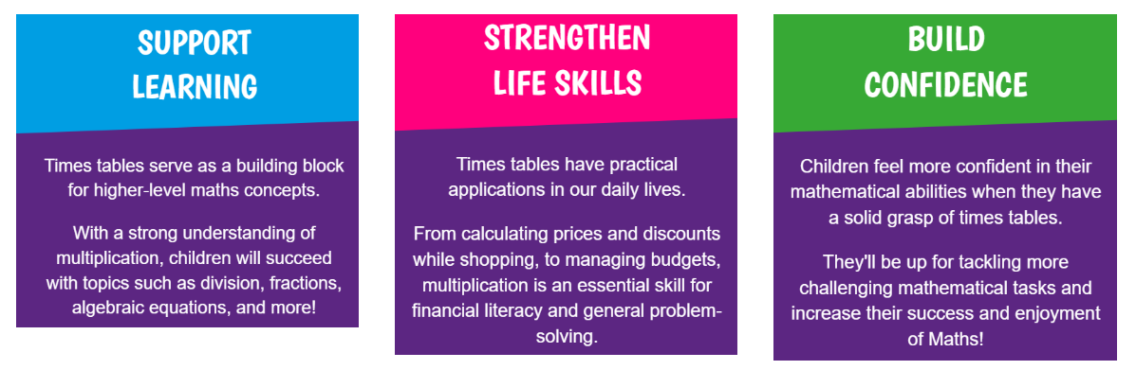
Knowledge of times tables is one of the building blocks of maths and reduces cognitive load to enable children to tackle their work with greater confidence. Multiplication underpins most areas of maths from area to fractions and beyond. There is a strong link between times table and division fact knowledge and SATS performance and overall engagement with maths.

Slide 6
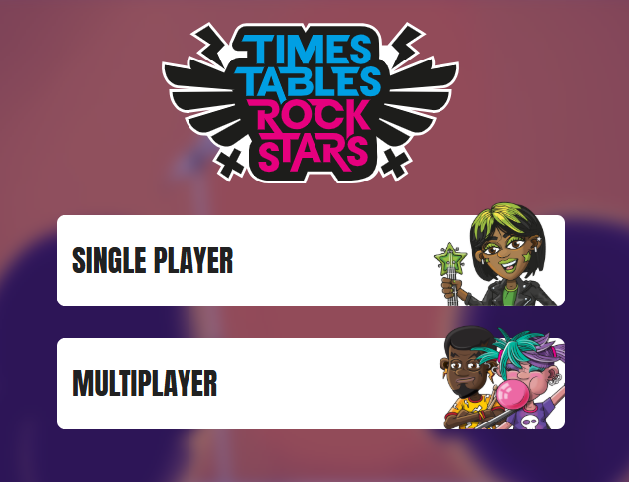
Within TTRockstars there are different game modes for the children to play. They may be set a particular game type by their teacher for homework or they can choose how they play.

Slide 7
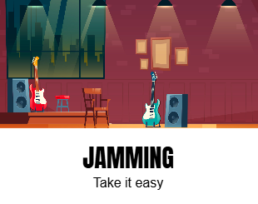
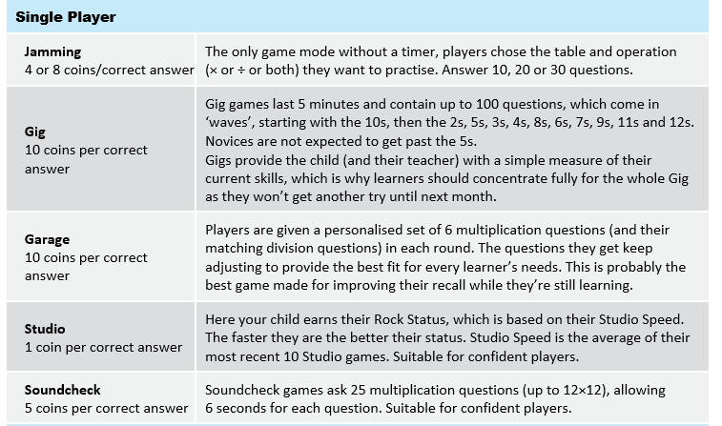
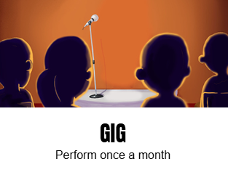
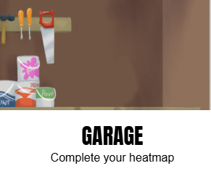
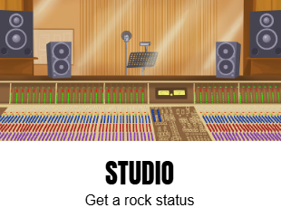
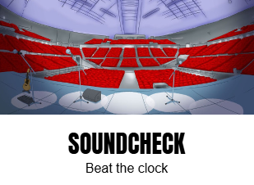

Slide 8
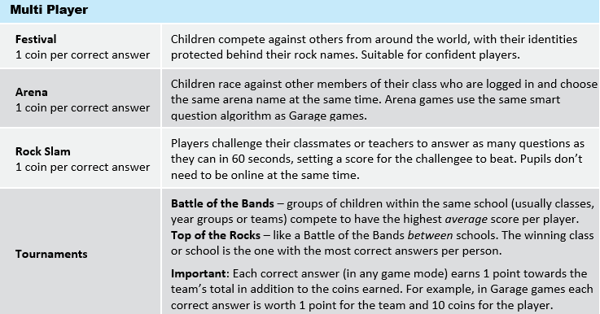

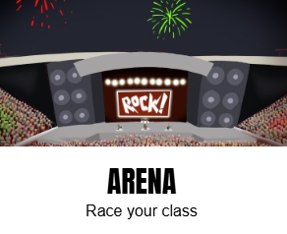
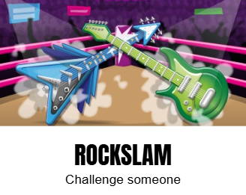
https://youtu.be/jWAn_JxMrWo

Slide 9

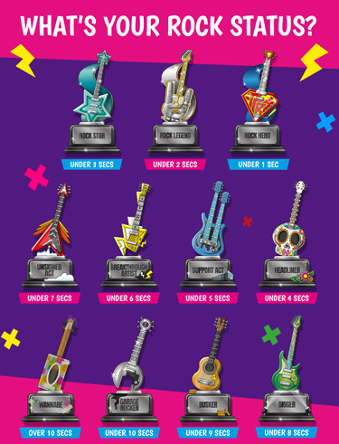
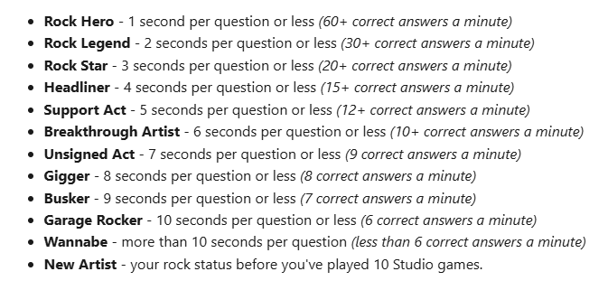

Slide 10
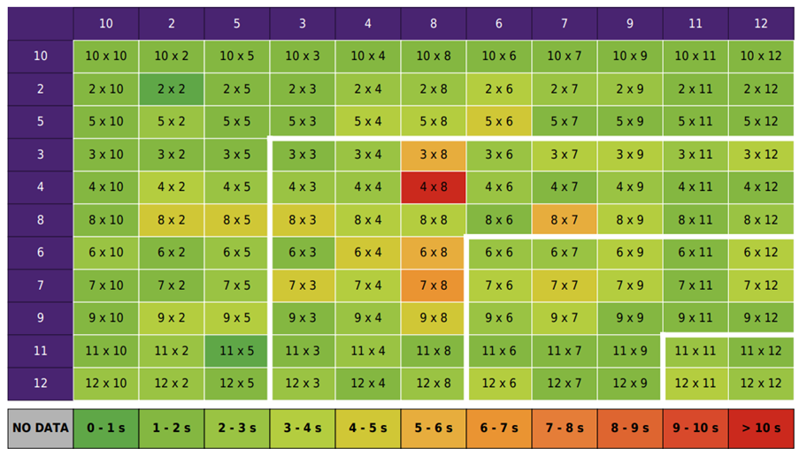
If a child clicks on their avatar icon in the top right of the screen and then clicks My Stats, a heatmap like the one below will load. It shows how successful they are at each of the facts. Teachers monitor these heat maps regularly and encourage children to target gaps in order to reach Gone Green status.

Slide 11
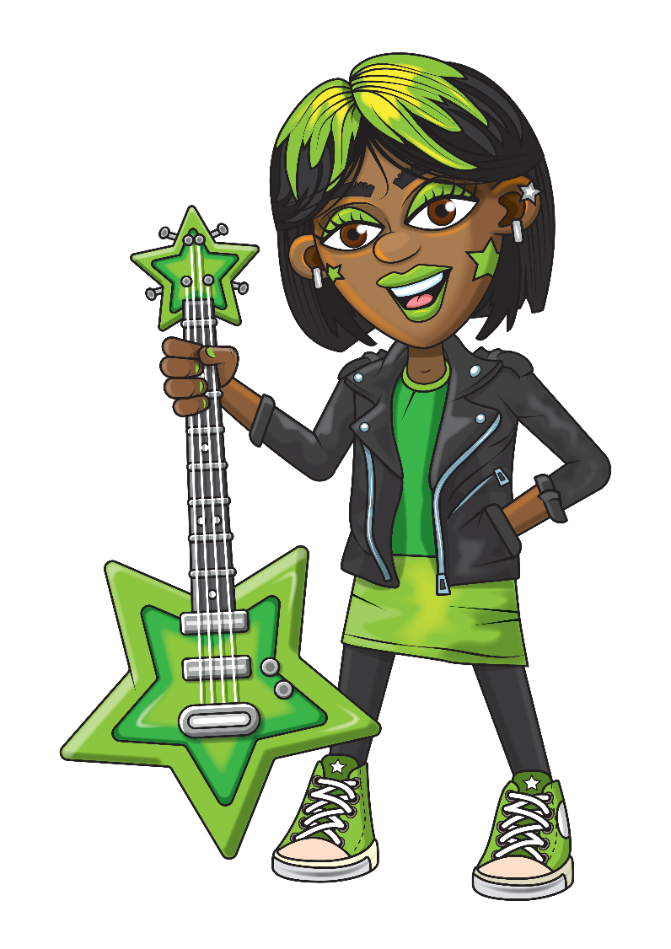
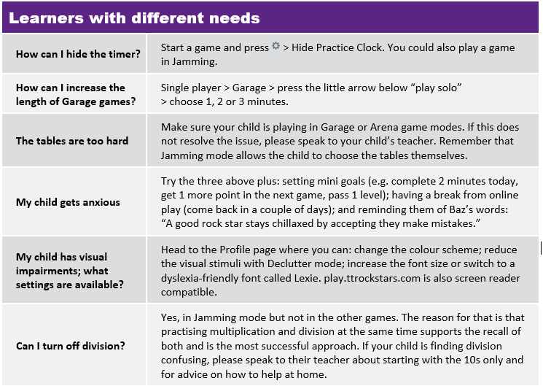

Slide 12
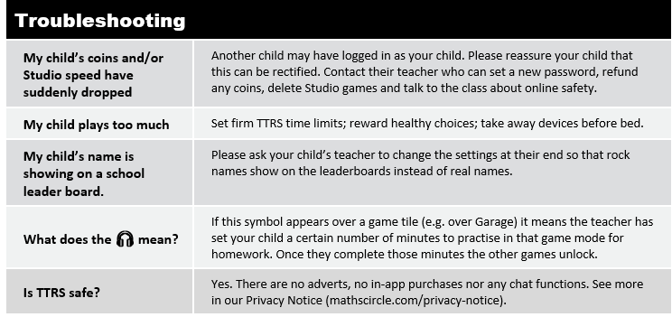
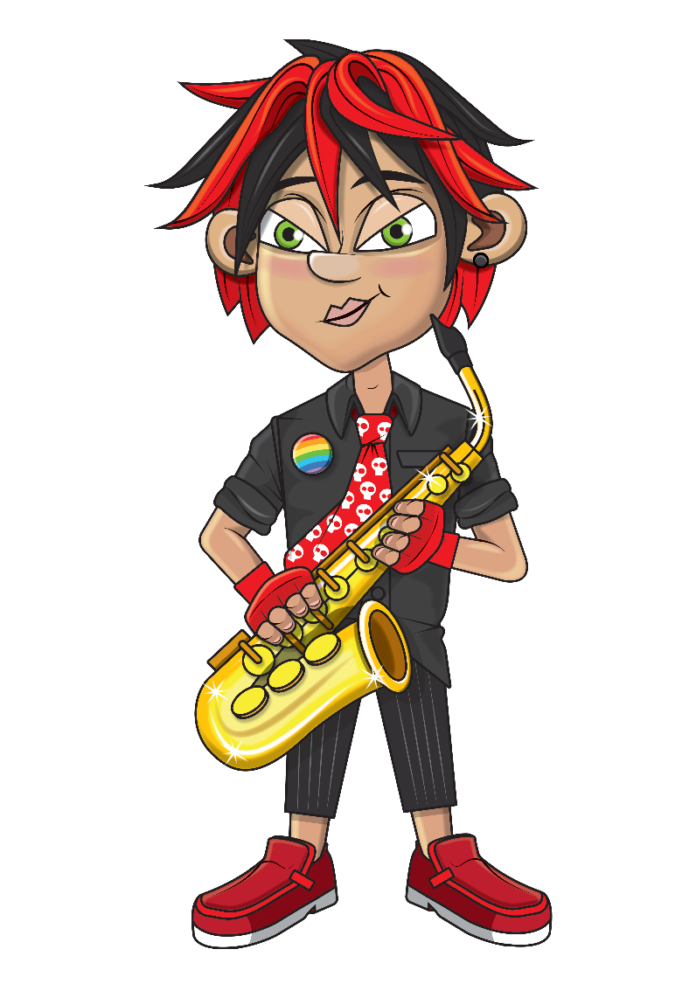

Slide 13
Let’s Play!
★Let’s have a look at the website.

Slide 14


Any questions?
https://ttrockstars.com/parents/

