Slide 1


Parent Information
‘We human beings were never born to read; we invented reading and then had to teach it to every new generation. Each new reader comes to reading with a 'fresh' brain - one that is programmed to speak, see, and think, but not to read.’
Maryanne Wolf

Slide 2

The Power of Reading
Every adult in our school needs to know HOW to teach reading…
WHY? The reading and writing of Standard English, alongside proficient language development, is the key to unlocking the rest of the academic curriculum. Ofsted.
One fifth of children leave primary school not being able to read
Reading one picture book to a child every day introduces them to 78,000 words every year
Evidence suggests that children who read for enjoyment every day not only perform better academically than those who don’t, but also develop a broader vocabulary, increased general knowledge and a better understanding of others.
In fact, reading for pleasure is more likely to determine whether a child does well at school than their social or economic background.
The Power of Reading
RWI Progression

Slide 3


Why RWI?
A RAPID learn to read programme so children read to learn for the rest of their lives
Tried and tested over many years
Systematic and structured
Early success in Reading
Training and ongoing staff development
Easy for parents to use

Slide 4


Who is it for?
EYFS and KS1
Older children who need to catch up – ‘interventions’
Children new to English
SEND pupils

Slide 5




How does it work?
What is Phonics?
Symbols:
It is essentially learning to read squiggles and sounds
The English language is one of the most challenging languages to learn simply because:
26 letters in the alphabet, 44 speech sounds and over 150+ graphemes
Teacher’s/carers need to be aware some sounds are different in some words, therefore, tongue placement will change.
‘th’
that
thick
then
thin

Slide 6



Decoding – ‘the mechanics’
Accuracy
Prosody
Fluency
c
a
t
.
.
.
Decoding
Sh
o
p
.
.

Slide 7
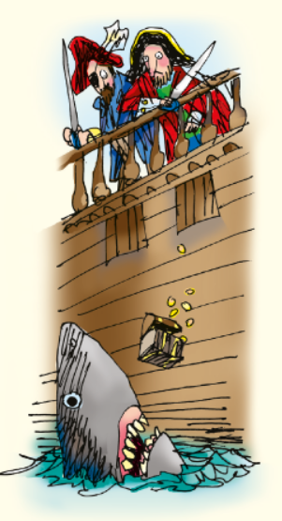
Comprehension
Children need to:
Talk a lot about what they have read to show they understand.
Listen to and discuss other ideas to help deepen understanding.
Fastest finger – (FF) retrieval questions, skimming and scanning skills
Have a think (HaT) – inference

Slide 8

Comprehension
Vocabulary
Inference
Children:
Talk a lot about what they have read to show they understand.
Listen to and discuss other ideas to help deepen understanding.
There are 6 main Comprehension skills that children will need to Master: We teach this through the Acronym VIPERS.
Prediction
Explanation
Retrieval
Sequence or Summarise

Slide 9
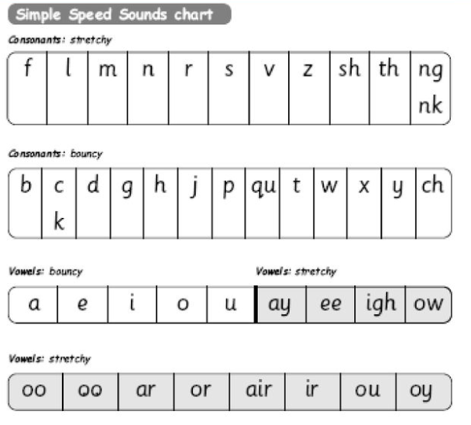
Simple Codes First
It is important that we use ‘pure’ sounds, such as:
‘s’ → suh
‘m’ → meh
‘l’ → leh
‘r’ → reh
r u n…
This is to help your child blend sounds easier
It’s here we also begin to teach the letter formation.

Slide 10
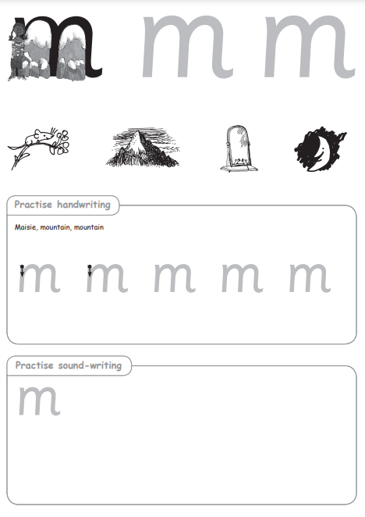
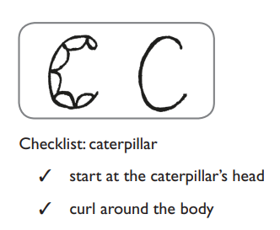
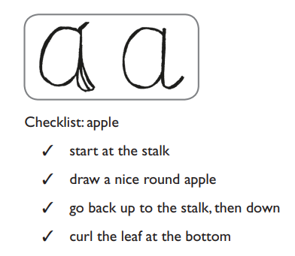
Simple Codes First
During these phonics session we will also teach the correct letter formation

Slide 11
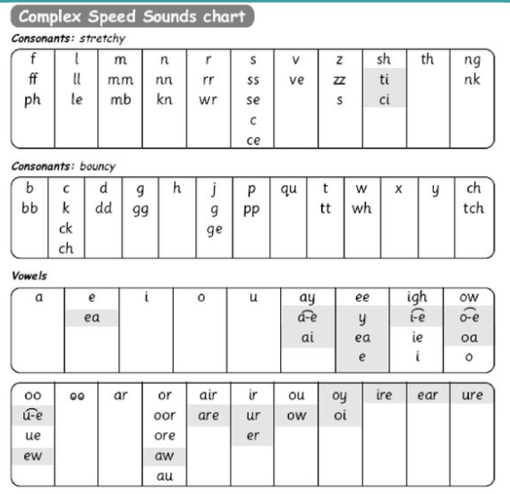



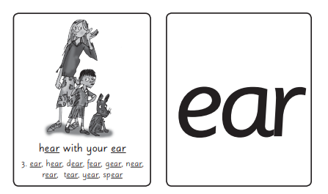
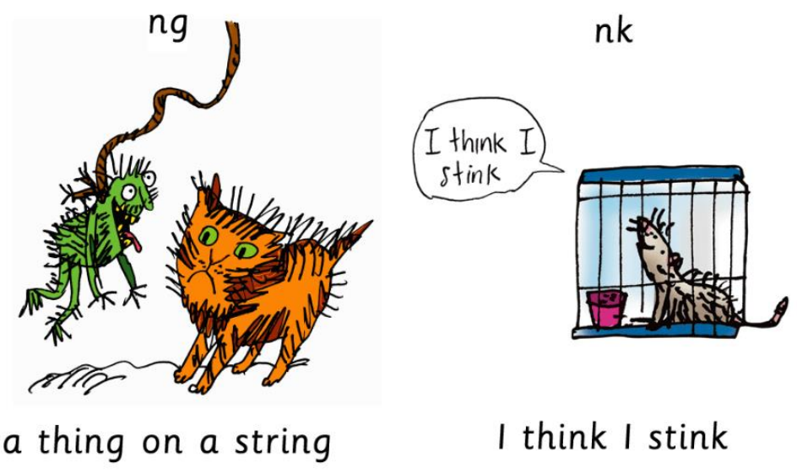
Complex Speed sounds chart
Special Friends
Digraphs/Trigrapghs

Slide 12
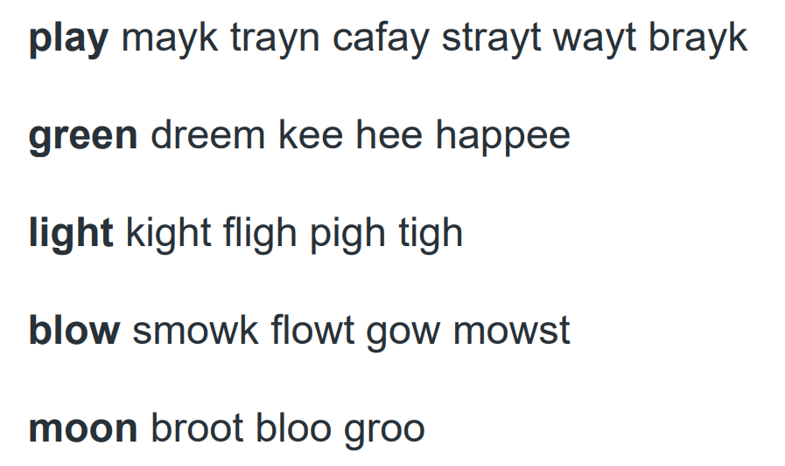
If… English had a simple code reading and spelling would be much easier

Slide 13
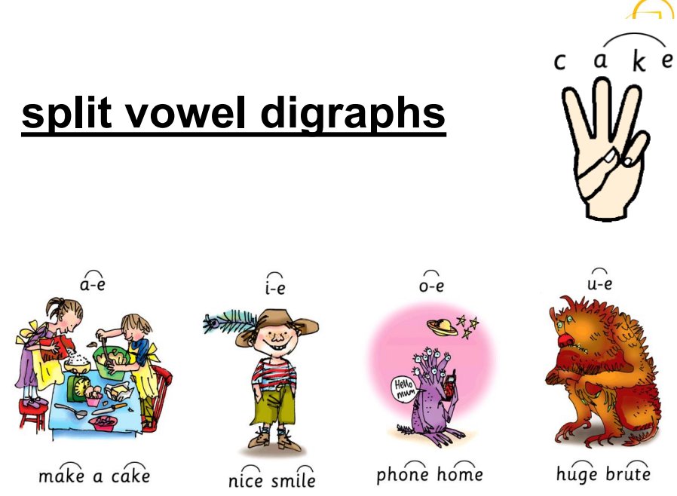
Set Three Sounds
After we learn our letter names we can then begin to learn the set 3 sounds. Most set 3 sounds are common alternative ways to spell sounds we already know. In set 3 we teach 2 other ways to spell ‘ay’ for example:
play
train
make

Slide 14
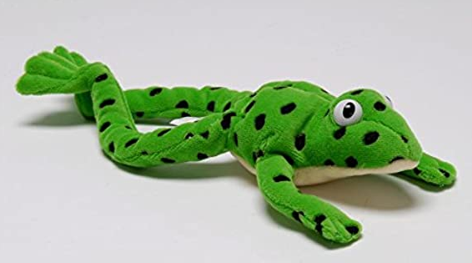
Fred Talk
Fred the frog helps children read. He can say the sounds in words, but he cannot say the whole word, so children need to help him.
To help children read, Fred (the teacher) says the sound and then children say the word.
E.g. Fred says c-a-t, children say cat; Fred says l-igh-t, children say light
This helps children learn to blend sounds.
Play Fred talk games:
Fred is thinking of a word??? f-r-o-g guess the word? l-u—n-ch (say it in syllables
Fred says.. (Simon says) put your hands on your h-e-d, put your hands on your h-i-p-s etc
Fred I spy…
Say: Fred has found some items from different parts of the house. What did he find in e.g. the food cupboard? Say each word in Fred Talk and pause to allow children to ‘jump-in’ with the whole word. Food cupboard: t-i-n, s-oo-p, b-ee-n-s, b-r-e-d, c-ay-k Fridge: m-i-l-k, j-oo-s, c-r-ee-m, e-g-s, c-or-n, p-air, p-ee-z, l-ee-k Kitchen: f-or-k, s-p-oo-n, n-igh-f, p-a-n, p-l-ay-t, b-ow-l; c-u-p; m-u-g; ch-air; s-t-oo-l Bedroom: b-e-d, r-u-g, b-oo-k, l-am-p, m-a-t, l-igh-t, b-o-x Bathroom: l-oo, s-i-nk, m-a-t, s-ow-p, b-r-u-sh, c-r-eem Wardrobe: s-c-ar-f, h-a-t, c-ow-t, s-o-c-s, sh-or-t-s, d-r-e-ss, s-k-ir-t

Slide 15



Green words – Fred Talk
Fred helps children to spell too
Children convert words into sounds
They press the sounds on their fingers
We call this Fred fingers

Slide 16

Red words
Red words are words which do not follow all the phonics rules we have been teaching them - unfortunately there are a lot in the English language!

Slide 17
RWI – How it works at St Martin’s
Stage not age – children are grouped based on their reading phonic level; ongoing assessments help identify children who are making speedy progress and children who may need more time
RWI books: children will read RWI books in phonics lessons at school - ‘storybooks’.
Book Bag books may seem easy…
Phonics lesson start at 9:00 sharp!
Mon | Tuesday | Wednesday | Thursday | Friday
*Return books x2 Book bag book sent home first read | Book bag book sent home 2nd read | Book bag book sent home 3rd read | Return book bag book New RWI book bag book | In class book – sent home 4th read Some children may also take home a reading for pleasure book

Slide 18
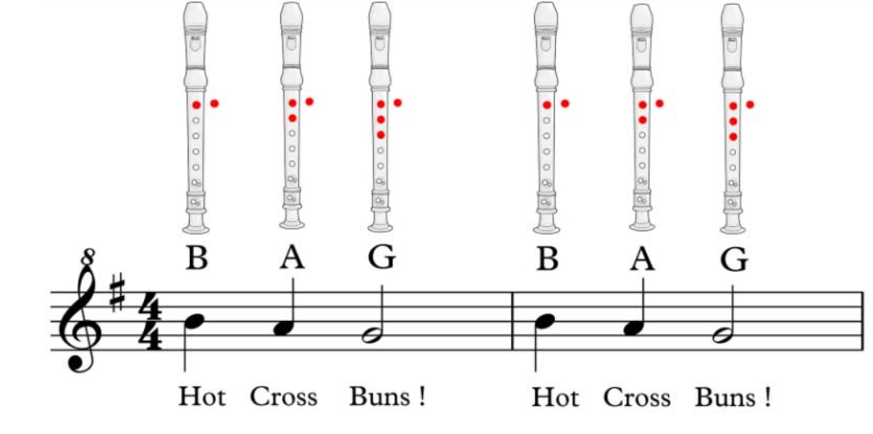
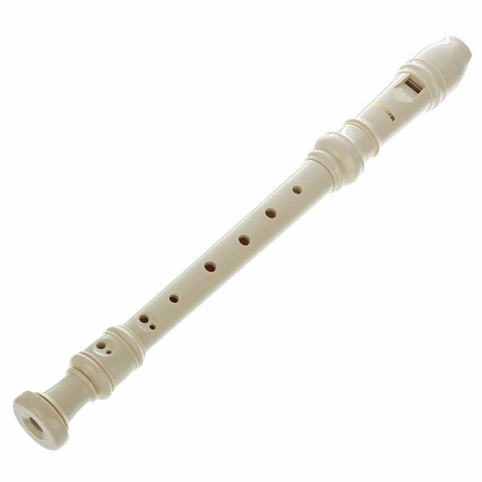
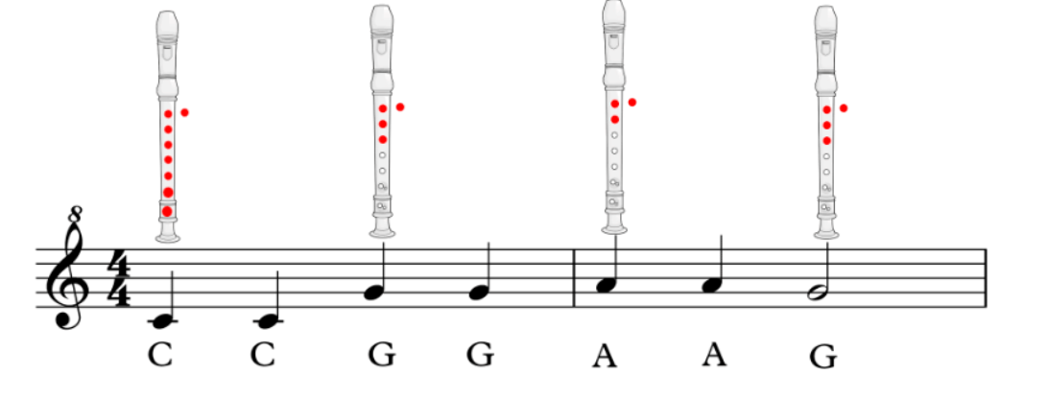
Book Bag Books
Practise
Practise
Practise
NO NEW LEARNING

Slide 19
'Three with me, four at home’
In our school, children read each Read Write Inc. Storybook three times in class with their partner.
Re-reading the same book helps children to become confident readers. Each time they re-read, they build their fluency/speed and comprehension.
They love reading and want to read because they can read all of the words in the Storybook.
We set a focus for each re-read in school.
First read: to read every word accurately - Fred talk
Second read: read more words at a glance with a story tellers voice
Third read: Read the whole story accurately, fluently and answering comprehension questions
Then your child brings the same book home to read and enjoy with you again and again at home. It’s ‘three with me, four at home.’
We do not send stories home the children cannot read because we always want them to be set up to succeed in their reading. We want to make sure they enjoy reading so that they want to read. The more they read, the faster progress they will make.

Slide 20
How you can help your child?
Reading one picture book to a child every day introduces them to 78,000 words every year
Using pure sounds only when saying sounds
Knowing all the sounds e.g ‘ng, igh, ure.. Etc
Using Fred to play games/ alien words
Reading lots and lots of different books by different authors
Ask different questions – to support comprehension
TALK to your children as much as possible and help enrich the conversations
‘Let’s eat our lunch?’
What do you think the character is feeling and why?
What might happen next?
devour
munch
scoff
What would you say to…?
What’s does din mean?
snaffle
gobble

Slide 21
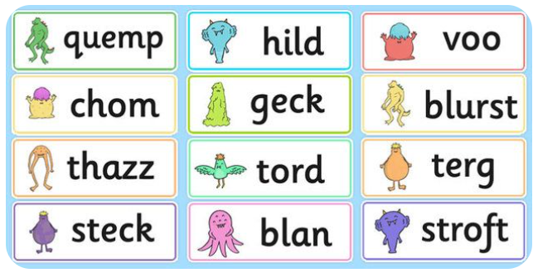
Alien words – phonics testing end of Year 1

Slide 22
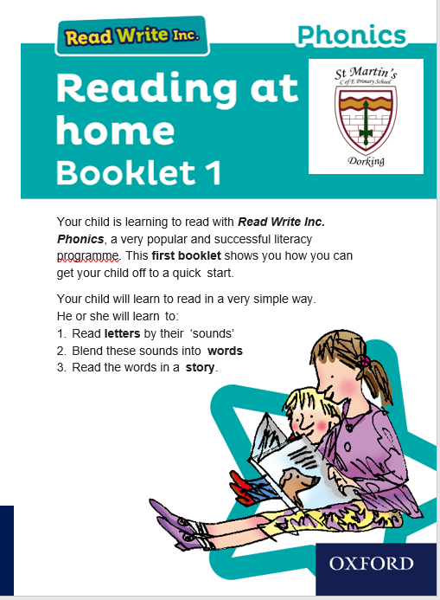
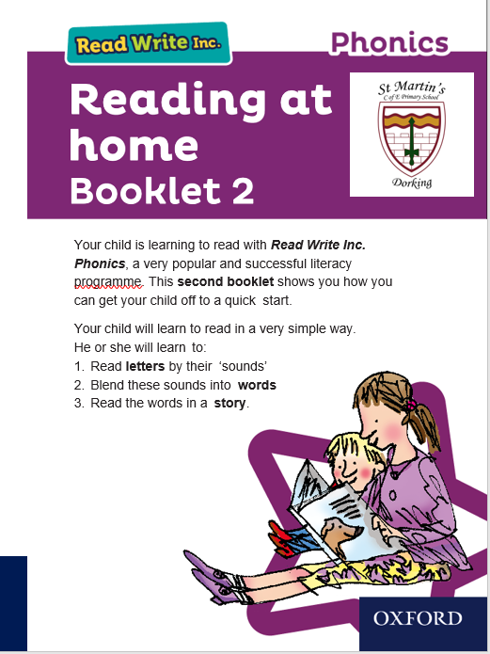
RWI useful websites:
Parent section for phonics: https://www.ruthmiskin.com/parents/
Refer to the parent information booklets 1 and 2
Online phonic games

Slide 23

ANY QUESTIONS?

