Slide 1

Year 3
Parent Information Meeting
Notes:
1

Slide 2
The Year 3 Team
Mrs Bex Royle and Miss Amy Pledge are teaching in Wren Class
Mrs Rebecca Legg and Miss Charlotte Holgate are teaching in Chaffinch Class
Supported by Mrs Britt, Ms Brooker and Mrs Waltho
Miss Lisa Ashdown is the Lower KS2 Phase Leader
SENDCo - Mrs Emily Berry and Mrs Kate Burnett with Mrs Alice Ingram supporting.
PE on a Wednesday - taught by LPA (Learn, Play, Achieve)

Slide 3
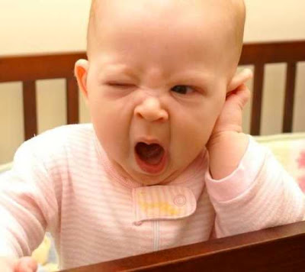
Morning Routines
The gates to the school are open at 8.30am every morning
Only children who are monitors are allowed to enter the classrooms before registration e.g. chair monitors
Children should stay out in
the playground before school
with their coats and bags
Late children must report to
the office

Slide 4

Afternoon Routines
ELATE children will go directly from the classroom every afternoon
Children attending clubs go directly to the meeting point for their clubs
Year 3 children line up on the playground for collection
It is important that we know who is authorised to collect your children from school. If there are any changes to arrangements, please let the office or the class teacher know
If you are late to collect your child for any reason they will wait on the blue chairs by the main office

Slide 5
Necessary equipment
Water bottle, with fresh water daily
Coat - Essential (Named please)
PE kit (Also named!)
PE is on Wednesday and Thursday. Children are not allowed to do PE wearing earrings or other jewellery
Clean trainers for use on the astro only
If your child cannot do PE for any reason, they must have a note please

Slide 6
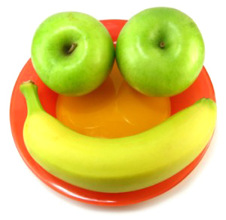
Mid-morning snacks
Fruit, vegetables or cheese
Cereal bars/biscuits/crisps must be kept for lunchtime
We have a no nut policy and with packed lunches we encourage the children not to share their food
Notes:
6

Slide 7
Worries and Concerns
Should you have any worries or concerns please let your child’s class teacher know. You could:
Write a brief note in your child’s diary and encourage your child to give it to the teacher
Make an appointment via the school office
Email your child’s class teacher

Slide 8

Parents Evening
Parents evenings: Autumn term - October
An email will be sent to you through Parentmail (please sign up) and then you will be able to book your appointment online
If you are not able to access the booking system, you can always ring the office and they will arrange an appointment for you

Slide 9
Diary/Reading Records
All children in KS2 will have a diary/reading record in which to record their spellings and reading.
The children can record the books they are reading but the diary needs to be signed at least once a week by a parent/carer and will be checked at school once a week.
Stickers will be given to children who have recording reading at least 3 times (per week).
We hope to change set reading books twice a week.
Diaries must come into school on a daily basis.

Slide 10
Home learning - Ongoing
Reading - Please encourage your child to read a wide variety of genres in year 3, at least three evenings per week (to be noted in diaries). Children working through the book bands must read issued books multiple times to aid their fluency and comprehension.
Spelling – Weekly word lists. These will be given out on Friday and are tested a week later.
Numbots – This will be set for the first term and we will move on to TTRS in the spring term.

Slide 11
Teaching & Learning
English and Maths are taught every morning
Broader curriculum subjects are taught in the afternoon
Links are made across the theme based curriculum, which builds on skills and values
An overview will be sent out each term
Notes:
11
Literacy & Numeracy:
Taught in ability groupings so that support & extension can be targeted where needed
Peer (through learning partners) & group support
Revisiting some topics taught earlier down in the school but from a different standpoint & developing specific skills

Slide 12
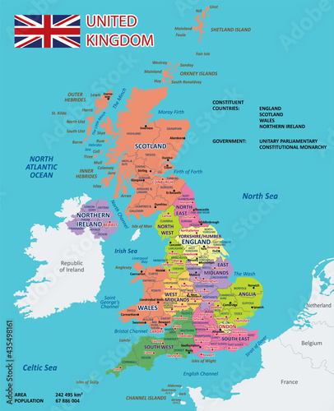
Geography book
Each class, throughout the school, has a Geography Home learning book which they can take home and produce an exciting piece of work about a part of the world.
In Year 3, we focus on the counties and cities of the U.K.
When your child brings the book home, they have 2 weeks to prepare a page or two - but not more - about the chosen county. They will then bring it back to share with the class.
The piece could include: maps, drawings, facts, holiday visits, interesting facts - basically any information about that county.
Notes:
12
Literacy & Numeracy:
Taught in ability groupings so that support & extension can be targeted where needed
Peer (through learning partners) & group support
Revisiting some topics taught earlier down in the school but from a different standpoint & developing specific skills

Slide 13
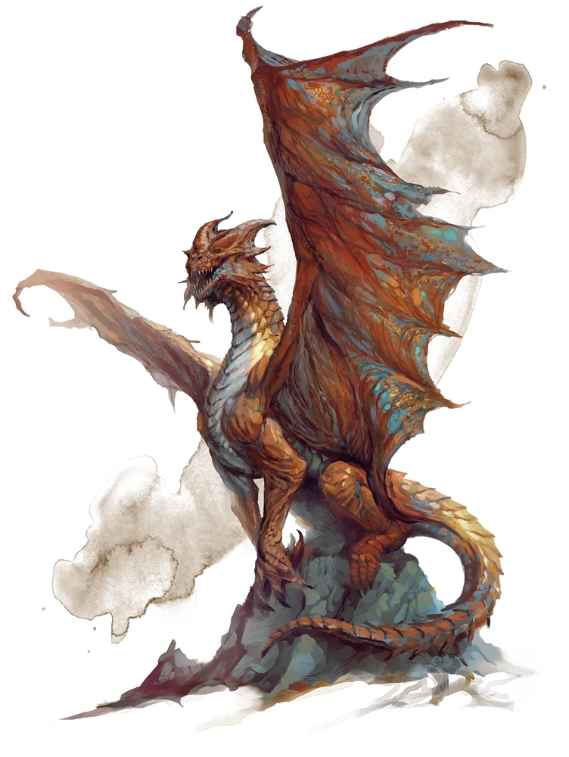
This Term’s Theme:
Myths and Legends
The children found a dragon’s egg in the school grounds and are becoming dragonologists, learning all about these magical creatures. This was an exciting start to our writing.
The theme also links to our work in art where
we have been looking at sketches of dragons by Leonardo Da Vinci and then we will create our own clay version of a dragon’s eye.

Slide 14
Teaching & Learning
Assessment for Learning (AfL) is used throughout the school to help children become more independent learners and to help them understand their learning journey.
Assessment for Learning (AfL):
  Learning Intention (LI)
  Steps to Success (Success Criteria)
  Share WAGOLL
  Self and Peer assessment
Notes:
14
Literacy & Numeracy:
Taught in ability groupings so that support & extension can be targeted where needed
Peer (through learning partners) & group support
Revisiting some topics taught earlier down in the school but from a different standpoint & developing specific skills

Slide 15

Swimming
Swimming will be in the Summer term
The children walk to the swimming pool (we will need volunteers to help with this please)
It is a National Curriculum requirement that all KS2 children can swim 25 metres

Slide 16


Slide 17

Year 3
Parent Information Meeting
Notes:
17

