Slide 1

Welcome to the Year 5
Parent Information Meeting
‘Inspiring children to be the best that they can be”
Notes:
1

Slide 2
The Year 5 team
(Kingfisher) Mrs Nadia White Tuesday - Friday
Ms. Brogden - Monday
(Jay) Mr Paul Johnson
LSAs in the teaching team
Mrs Blanks
Mrs Holden
Ms Bartlett
Ms Brogden
Tuesday afternoon
Mr Andrews - (Outdoor PE) & Mrs Holden French
Notes:
2

Slide 3
Morning Routines
The gates to the school are open at 8.30am every morning. Year 5 should arrive by 8.40am. The gate will close at 8.45am.
Late children must report to the office.
Notes:
3

Slide 4

Afternoon Routines
After School Club children will be sent by their teacher.
Children attending clubs will be sent by their teacher. They should go directly to the meeting point for their clubs.
All year 5 children being collected by parents should be collected from the car park at 3.30pm.
It is important that we know who is authorised to collect your children from school.
Children in year 5 are becoming more independent and some walk all (or part of the way) home, but do need a permission letter to this effect.
Notes:
4

Slide 5

The school is unable to authorise absences for holidays so PLEASE take your family holidays during the 13 weeks that are allocated, each year for this purpose. Thank you so much. If you have a request under ’exceptional circumstances’ please put this in writing and address it to Mr Tuckett.
Notes:
5

Slide 6

Necessary equipment
Named water bottle, with fresh water daily.
Named coat – we will be going out in the rain!
Pencil case
Reading diary
Outdoor PE is on a Tuesday and Outdoor PE is on a Thursday.
Please ensure PE kit is worn for those days.
Children are not allowed to take part in PE wearing earrings.
Non attendance from PE must be accompanied by a note.
Notes:
6

Slide 7

Mid-morning snacks
Fruit, vegetables or cheese.
Cereal bars / oatcakes / dippers / biscuits must be kept for lunchtime.
Please remember we are a “nut free” school.
Notes:
7

Slide 8

Mobile Phones
We are able to keep mobile phones safe. Children should personally hand their phone to their class teacher at the beginning of the school day and we will return them at the end.
Children should not keep mobile phones on during the day, neither in their bags, trays nor pockets.
Notes:
8

Slide 9
Meeting Teachers
Should you have any worries or concerns. please let your child’s class teacher know:
Write a brief note in your child’s planner/diary – we will ask daily if there is a message for us.
Send an e-mail to parents@stmps.uk
Home learning diaries are checked every week – please ensure you have signed your child’s diary weekly.
Notes:
9

Slide 10
Homework
This will be set weekly on a Tuesday and due by Monday.
English will be either comprehension or grammar – 20 minutes.
Maths will be a worksheet linked to current learning – 20 minutes.
TTRS – 10 minutes each week.
Homework books will be sent home each week where the work should be recorded.

Slide 11
Homework
Reading – children need to be reading a wide variety of genres in year 5 - at least three evenings per week but every evening would be amazing (reading MUST be recorded in their diaries).
Spelling – our initial focus will be on reinforcing and learning high frequency words, common homophones and Year 4 and 5 spelling rules. Spelling lists will be set weekly.
Spellings set and tested each week on a Monday.
Spelling books – these will be sent home weekly
Notes:
11

Slide 12
Geography Book
On a Monday, one child from each class will have the opportunity to take home the Geography book.
In Year 5, we use this book to find out about:
North and South America
Choose a country from North/South America - there is a map in the back of the book.
Once children take the book home, they will have a week to put together their learning (Monday to Monday).
The focus is on including their main physical characteristics (e.g. mountains, rivers, climate, animals) and human characteristics (e.g. parks, population, religion).
Once they have brought the book back, they can then present their learning to the class.
This information can be found in the inside cover of the book - you don’t need to remember it all!
Notes:
12

Slide 13

Meeting Teachers
Parents’ evenings - in the hall.
Tuesday 3rd November
Thursday 5th November
Please book an appointment online.
If for any reason you cannot make these, please talk to us to find an alternative time.
Notes:
13

Slide 14
Teaching & Learning
Stronger starts (8.45 – 9.05)
2 x Letterjoin, 2x SPaG, 1x maths
English and Maths are taught every morning.
Broader curriculum subjects are taught in the afternoon and cross curricular links are stressed where possible.
A theme based curriculum which draws upon multiple skills.
Notes:
14

Slide 15
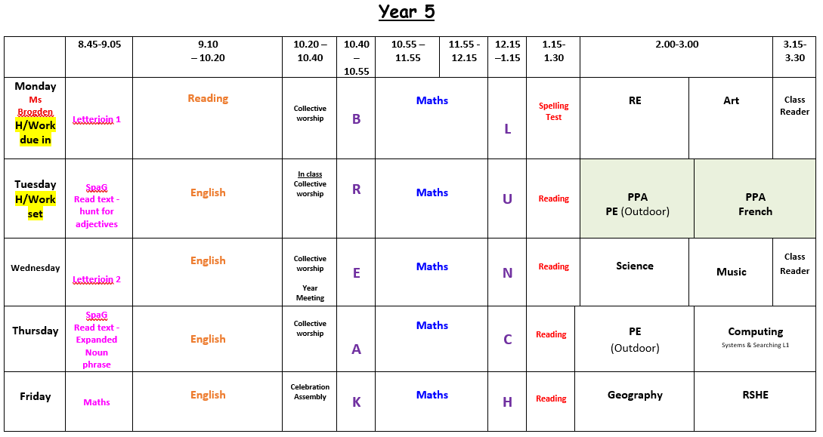
PE
PE/French
RE

Slide 16
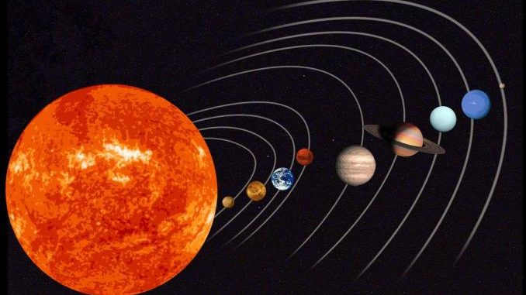
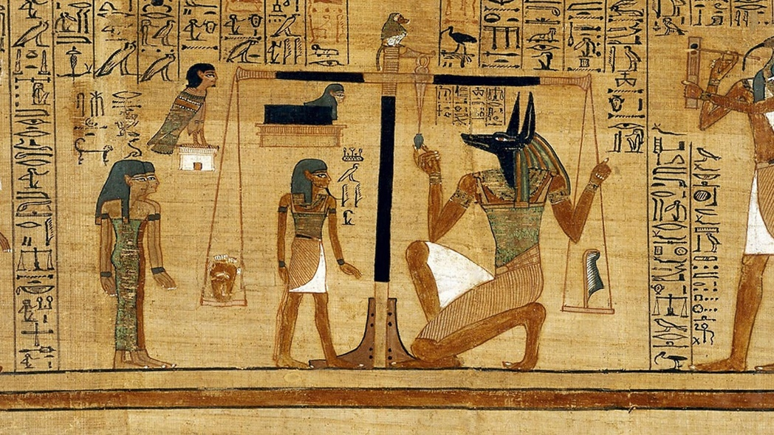

YEAR 5 THEMES
Space
The Ancient Egyptians
Rivers
Notes:
16

Slide 17

Our first WOW day will be Thursday 15th October based on our SPACE topic.
We will be visiting the Science Museum!

Slide 18

Residential trip to SAYERS CROFT
Year 5 will attending their 3 day (2 night) residential trip to Sayers Croft in Ewhurst on the April 26th. Here they take part in a range of indoor and outdoor activities as part of their RSHE, Geography and PE education.
There will be a presentation in the New Year outlining the trip in more detail.
Notes:
Rachel
18

Slide 19
Thank you
‘Inspiring children to be the best that they can be”
Notes:
19

