Slide 1

Y6 Parent Information Meeting
14th September 2026
Welcome
“Be kind, do your best”

Slide 2
Year 6 - Aims
Develop independence and confidence
Be secondary school ready
Complete primary school successfully
Have a memorable experience to finish at St. Martin’s

Slide 3
Year 6 – The Team
Class teachers – Falcons – Mrs Evans, Eagles – Mrs Jones
LSA’s – Miss Carter, Mrs Angus, Ms Zsofia, Mrs Waltho and Mrs Blanks
PE – LPA Coaches – Mr Cook

Slide 4
Year 6 - Attendance
Regular attendance is really important
Please do not take any days out of this school year – unless your child is ill
80% attendance = 2 years lost learning by the time children are 16!

Slide 5
Year 6 - Routines
The gates to the school are open at 8.30am every morning. Children will come into the playground when they arrive in the morning.
8.40am – into classrooms – Strong Starts
Walking home - Please ensure your permission letter is now with the office.
LUNCHES – please ensure you have ordered & let your child choose in advance
PE
Children should remove earrings. (PE Teachers will advise)
Non attendance from PE must be accompanied by a note/email.

Slide 6
Year 6 – Essential Equipment
Named water bottle – with fresh water daily
Reading book from home
School Diary
Named Pencil case – named stationery – handwriting (blue) pen, purple pen, glue stick, pencil, rubber and 30 cm ruler.
Waterproof coat - Clearly named

Slide 7
Year 6 – Medicine / Watches / Phones
EpiPens/inhalers – spares in school please
Phones – handed in to class teachers on arrival
Apple/Smart watches are not allowed in school

Slide 8
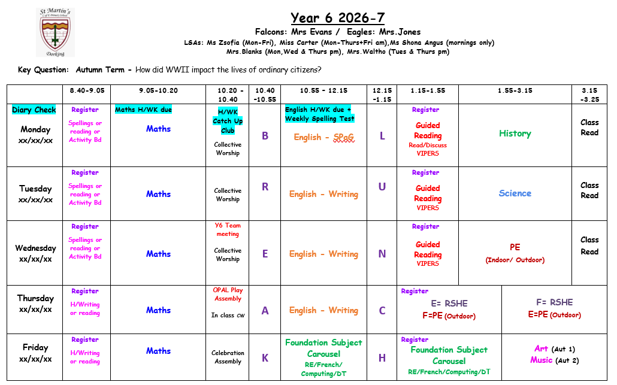
Year 6 - Timetable

Slide 9
Year 6 - Themes
Autumn | How did WW2 impact the lives of ordinary citizens?
Spring | How did Picasso’s work represent his attitudes, beliefs and emotions? Why did the Vikings try to take over the country and how close did they get?
Summer | What is the economic activity of the UK and how sustainable is it? Business Enterprise Project Cuffley Residential

Slide 10
Year 6 – WoW Days
WW2 Wow Day in school – Thursday 8th October
Viking Wow Day in school - March 2027 - tbc

Slide 11
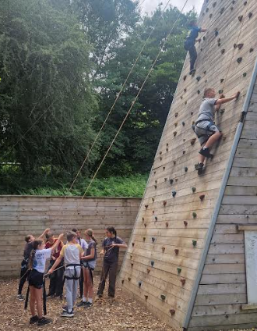
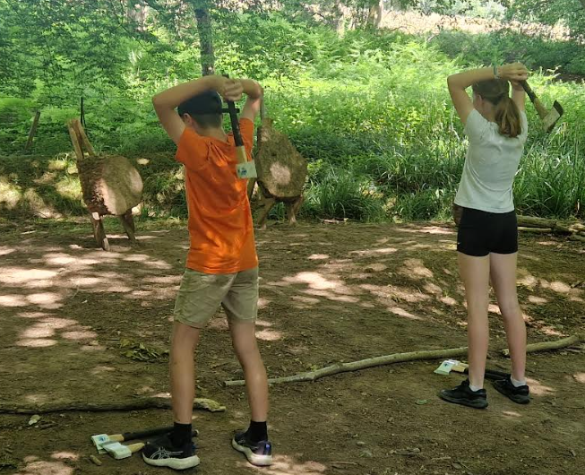
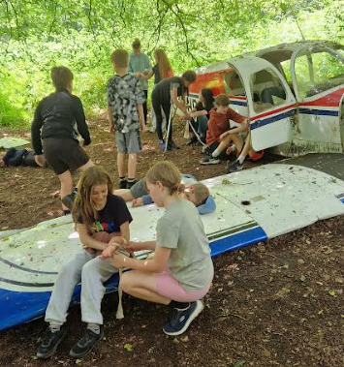
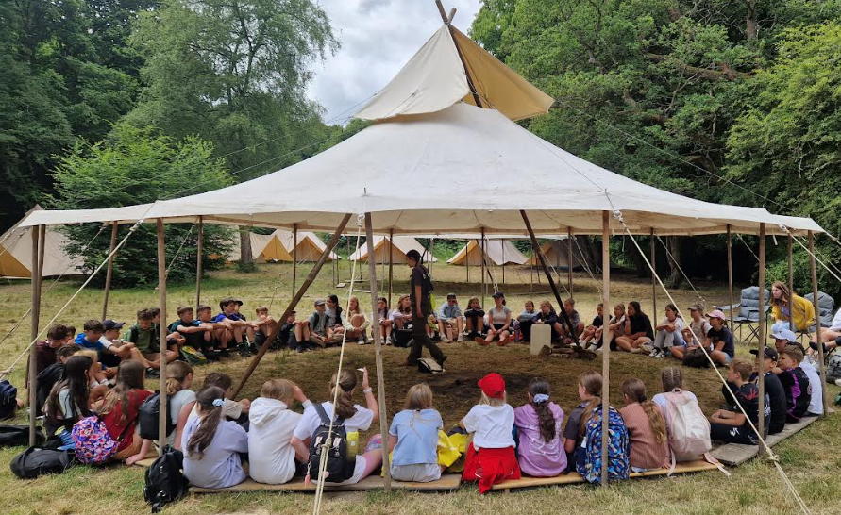
Year 6 – Residential - Cuffley
Monday 21st June – Friday 25th June
Camping in bell tents
Activities include :-
- crate stack
- camo concealment
- climbing
- axe throwing
- archery tag
- Team Problem solving/1st Aid
Parent meet nearer the time
https://activelearningcentres.co.uk/locations/cuffley/

Slide 12
Year 6 – SATs - 2027
10th - 13th May 2026
Monday - Thursday
Information evening nearer the time!

Slide 13
Year 6 – Teaching and Learning
Grouping for success - Fluid
Guided Reading takes place x3 weekly.
Foundation curriculum subjects are taught using a cross curricular approach.
We use a theme based curriculum which builds on your child’s social skills, emotional resilience as well as academic potential.

Slide 14
Year 6 – Homework
In Year 6, your child will have 4 core pieces of homework every week:
Maths - (maximum 30 minutes) will be set/due on Mondays.
Times Tables Rockstars (10 minutes per week).
English - (maximum 30 minutes) will be set/due on Mondays.
Weekly spellings will be set and tested on Mondays
Class Geography Book: One child will take home each week to record an information page(s) about a country/place of their choice from around the world.

Slide 15
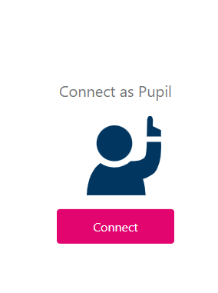
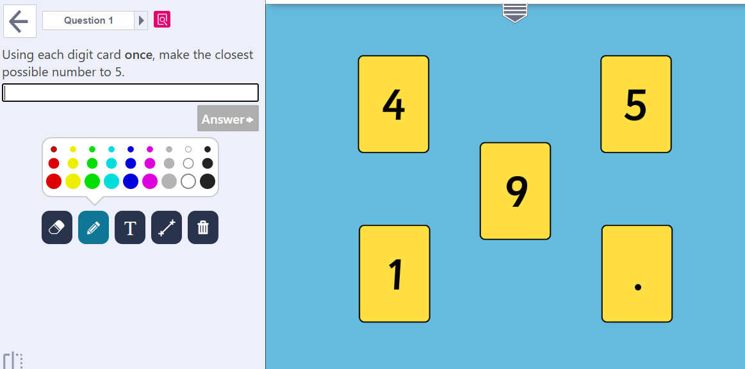
Year 6 – LBQ
https://www.youtube.com/watch?v=e_5rMJFqcrg&t=5s

Slide 16
Year 6 – Interventions
As always, we will be targeting some children for additional support this year.
Writing / GR
Arithmetic / Times Tables / Reasoning
Priority Readers
SALT
ELSA
Circle of Friends
Jellyfish
Pre Teach

Slide 17

Year 6 – RSHE
Sex education is part of the RSHE curriculum for the Summer Term and will be led by the Class Teacher and Surry school Nurse Team.
There will be a parent meeting closer to the time.

Slide 18
Year 6 – Bikeability
The Bikeability course will be held in the Autumn Term.
Daily sessions will run from the week of the
2nd November or the 16th November.
Letters will go home about this.
  All children taking part will need a ‘roadworthy’ bike and helmet.

Slide 19
Year 6 – Secondary School Choices
Parents are encouraged to apply online. We can provide support if required.
You can still apply on paper, but you are responsible for ordering the necessary paperwork. Please ask the office if you need help.
Further information can be found at: https://www.surreycc.gov.uk/schools-and-learning/schools/admissions/secondary
Stage of process | Date
Application period starts | 1 September 2026
Closing date for applications | 31 October 2026
Outcome of applications | March 2027

Slide 20
Year 6 – Parents’ Evening
Parent’s consultations:
Tues – 3rd Nov - 3:40 - 7pm
Thurs – 5th Nov - 3:30 - 7pm
These appointments are for 10 minutes and can be made by signing up online or calling the office.
A parentmail will be sent out once the appointment times are made available.

Slide 21
Year 6 – Contact Us
Should you have any worries or concerns, please let your child’s class teacher know.
Please contact us via school office if you wish to email/speak to us directly.
Our doors are always open – pop and see us – before or after school – just let us know and we can arrange a time to suit you.
Questions

